Slide 1
Внеклассное мероприятие по английскому языку «The field of Wonders»
Волоконская Наталья Викторовна
учитель английского языка
МБОУ ТСОШ №2
ст. Тацинская
2016-2017 учебный год

Slide 2
The field of Wonders

Slide 3
Famous people

Slide 4
Цели и задачи:
актуализация изученного материала по теме "Знаменитые люди";
тренировка навыков монологической речи;
активизация букв английского алфавита;
развитие интереса учащихся к изучению языка.

Slide 5
Ход мероприятия:
- Good morning, boys and girls! Today we’ll play the most famous game “The field of Wonders”. Our topic is “Famous people”. We’ll remember some famous people of this country. What famous people do you know? Please, first boys and girls, come here.Let’ s start .First tell us about yourself.
(Участники представляются)

Slide 6
Painter
Scientist
Writer
Architect
Actor
Musician
Poet
Politician
Actress

Slide 7
Match the English words and their Russian equivalents:
Painter
Scientist
Writer
Architect
Musician
Poet
Politician
Actor
актер
музыкант
политик
поэт
художник
ученый
писатель
архитектор

Slide 8
First round
She is well - known all over the world as the Queen of Crime. She wrote 78 detective stories. Her books are translated into 103 foreign languages. She was born in England. She was educated … and took singing lessons in Paris. She began writing at the end of the First World War. Her books are the third best-selling books in the world.

Slide 9
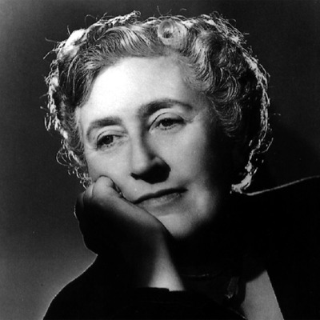
Agatha
Christie

Slide 10
Second round
He was best known as a singer, songwriter, poet and guitarist for the British rock band The Beatles. His creative career also included the roles of solo musician, political activist, artist, actor and author. He heavily influenced the development of rock music. Many of his songs such as "Imagine" and «Strawberry Fields Forever «are often ranked among the best songs in popular music history. In 2002, the BBC conducted a vote to discover the 100 Greatest Britons of all time, and the British public voted him into 8th place.

Slide 11
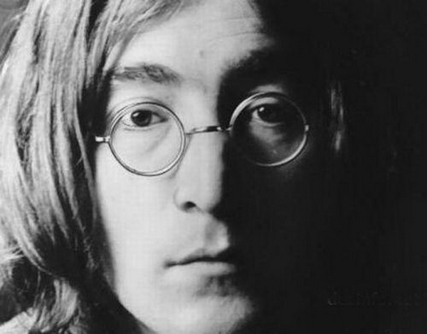
John Lennon

Slide 12
Third round
He is one of the most popular stars of the early days of Hollywood. He lived an interesting life both in his films and behind the camera. He is most recognized as an icon of the silent film era. He is the man with the toothbrush mustache, bowler hat, bamboo cane, and a funny walk.

Slide 13
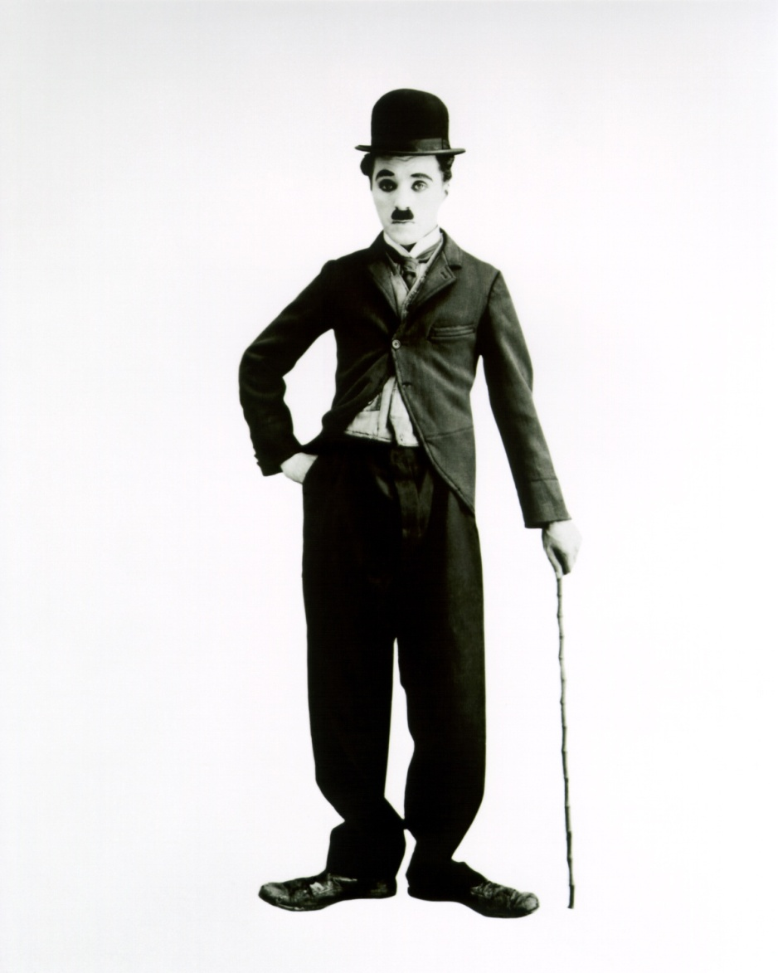
Charlie
Chaplin

Slide 14
Final
He is one of the greatest and most famous writers in the world. At first he was an actor. Then he began to write plays. In his works he described the most important and dramatic events of life. His plays were staged in many theaters, translated into many languages and they made him a very popular man.

Slide 15
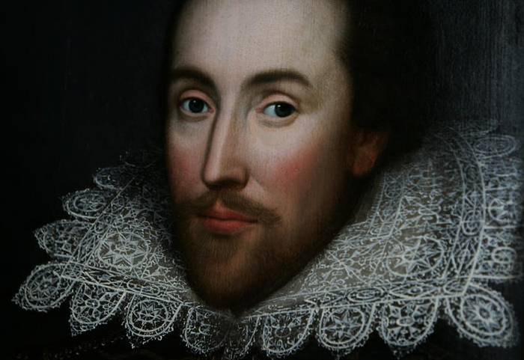
William Shakespeare

Slide 16
Super Game
She was born on 21 of April 1926 in London. Actually she has two birthdays. She was educated privately at home. On 6 February 1952 I became Head of the Commonwealth and queen regnant of seven independent Commonwealth countries: the United Kingdoms, Canada, Australia, New Zealand, South Africa, Pakistan and Ceylon. She is married. Her husband is Prince Philip. She has four children: Charles, Anne, Andrew, and Edward.

Slide 17
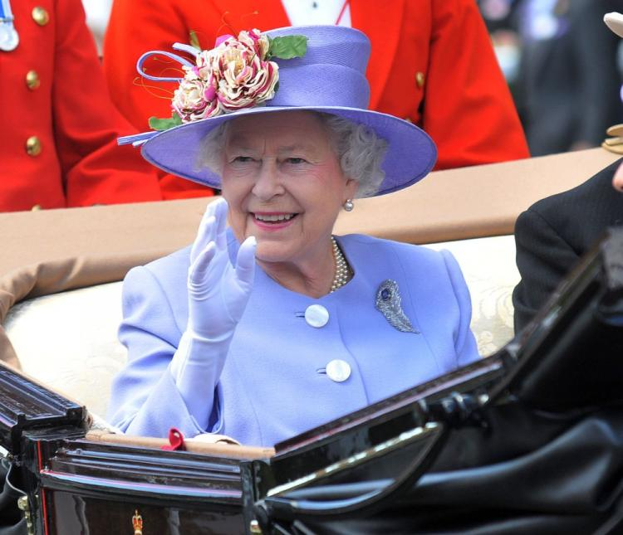
Queen
Elizabeth II

Slide 18
Make up sentences:
W. Shakespeare famous writer
Ch. Chaplin well-known musician
A. Christie outstanding politician J. Lennon (is) was a (an) popular writer
Elizabeth II world-famous actor

Slide 19
Рефлексия:
сегодня я узнал…
было интересно…
было трудно…
я выполнял задания…
я понял, что…
теперь я могу…
у меня получилось …
меня удивило…
урок дал мне для жизни…
мне захотелось…

