Slide 1
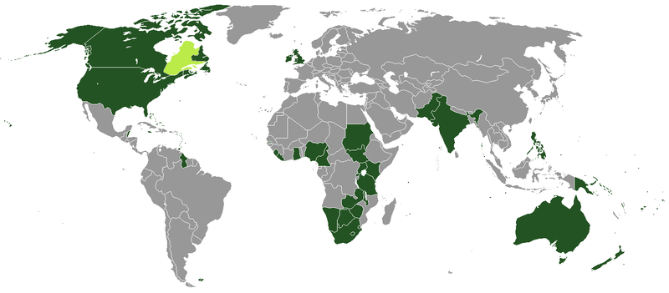
Welcome to English-speaking countries
Методическая разработка внеклассного мероприятия по английскому языку «Добро пожаловать в англо-говорящие страны!»
Учитель: Приходько Елена Петровна
МБОУ Тацинская СОШ №2
станица Тацинская
2016 г.

Slide 2
Задачи:
Совершенствовать речевые умения учащихся по страноведению
Воспитывать культуру межличностного общения, уважение к культуре других стран
Развивать творческие способности учащихся, воображение, догадку
Совершенствовать навыки письма, чтения через внеклассную работу
Оборудование:
мультимедиа, CD, костюмы, маски

Slide 3
Ход мероприятия:
Good morning! Dear students and teachers! I am glad to see you again. Welcome to our project, which is called «Welcome to English speaking countries». They are the UK, The USA, Canada, New Zealand and Australia.The are 5 teams which are from different Schools. Each school should represent its own country. Our participants should tell some words about countries, take part in blitz-tour, write personal letter to English friend and read. The members of the team will read and listen different texts. I am sure, you will like this game.
So, the first round… .
You should represent each own country.

Slide 4
The First round – taking part in blitz- tournament. You should answer my questions. You will say only one word – the name of the English – Speaking country. You should be very attentively.
The first task is Countries.
It is the world’s second largest country. Its capital is Ottawa.
It is an independent state. Its capital is Wellington.
It is an Island state. It consists of 4 countries.
The capital of the country was named after the first President. What country is it.
The capital of the country is Canberra.
The kiwi is the symbol, of this country.
It is the smallest continent.
It is situated in the North-American continent.
The largest cities are Dublin, Manchester, Belfast.
It is called Land of Up-Side Down
There is a marple leaf on its arm-coat.
Bald eagle is the symbol of the country
It is situated to south-east of Australia.
The leading cities of the state are Toronto, Vancouver.
It is a parliament monarchy.
The Mississippi is the main river of the country.
It is a federation of 10 provinces and 2 territories.
Dingos, koalas, kangaroos are animals from this country.
It is a self governing state. The Parliament consists of one House, the House of Represantatives.
Red rose is a symbol of one of the countries of its state.
Boston, Chicago, Sanfrancisco are the main business centres of the country.
Cambridge University, Oxford University are the most famous universities of the country.
Auckland, Wellington, Nelson are the main ports of this state.
The capital of this country is Canberra.
Both English and French are official languages of the state.

Slide 5
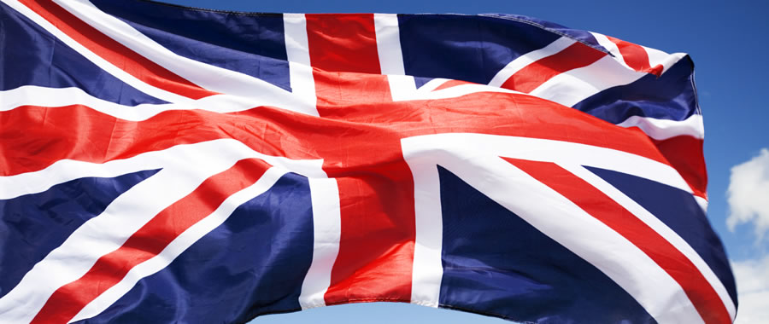
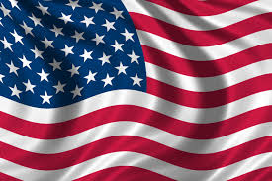
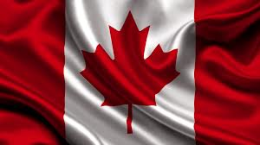
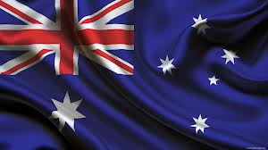
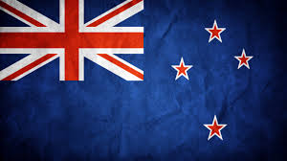
The UK
2. The USA
3. Canada
4. Australia
5.New Zealand

Slide 6
The second task is National dishes
It is eaten in the Eve of Christmas. It is a dessert.
It is a fizzy drink. It was invented by Pemberton.
The time of this meal is 5 o’clock.
It is stuffed with herbs. It is a favourite dish of Americans.
It is a national dish. It is prepared by Americans at Thanksgiving Day.
It is a national dish. It consists of two dishes.
It is a drink. I think, it is not healthy.
This dish was prepared by Indians. It is made of pumpkin. It is a pie.
The British like it very much. It is their tradition. They drink it very often.
Tourists want to try this dish. It is not a dessert.

Slide 7
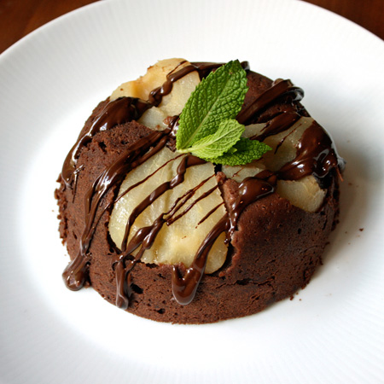
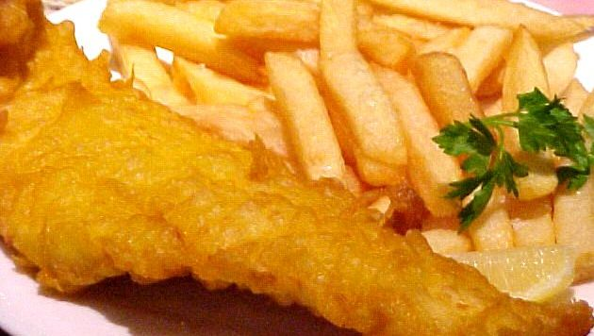
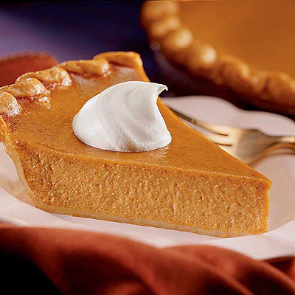
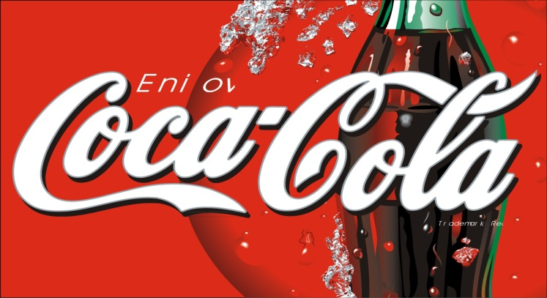
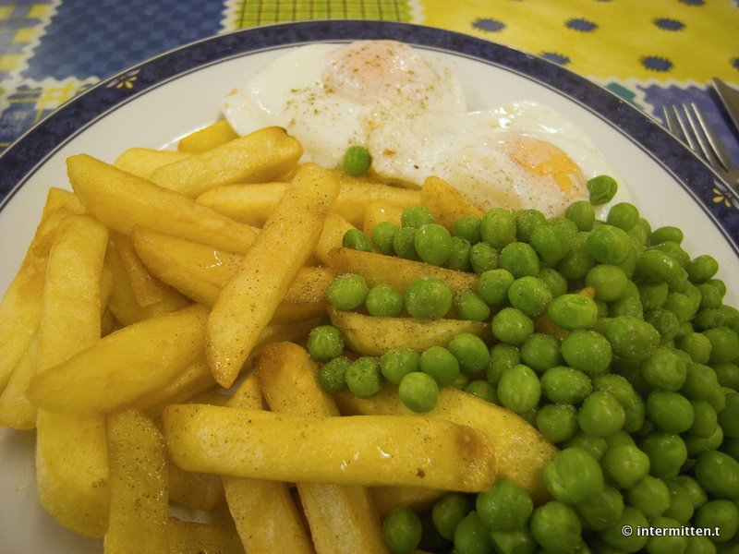
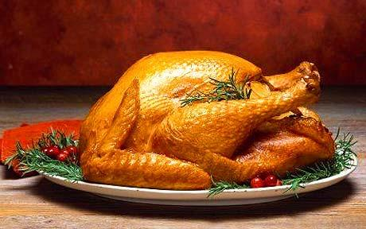
National dishes
English pudding
Fish and chips
Pumpkin pie
Coca-Cola
English tea
Stuffed turkey

Slide 8
The third task is Holidays
It is celebrated on the 4 ^{th} of July. It is an American tradition.
It is celebrated on the 17 ^{th} of March in Ireland.
Pumpkin is the symbol of this holiday.
It is a Russian tradition People like eating pancakes.
It is celebrated on the 25 ^{th} of December in the catholic countries.
It is the most favourite tradition in Russia. People decorate New Year’s trees.
The favourite colour of this tradition is green. It is celebrated in spring
People like riding on troika, say “good bye” to winter. It is celebrated in Russia.
Children like trick-or-treating. They dress as witches, skeletons and monsters.
This is a national holiday oh the USA. People rise flags, take part in parades.

Slide 9
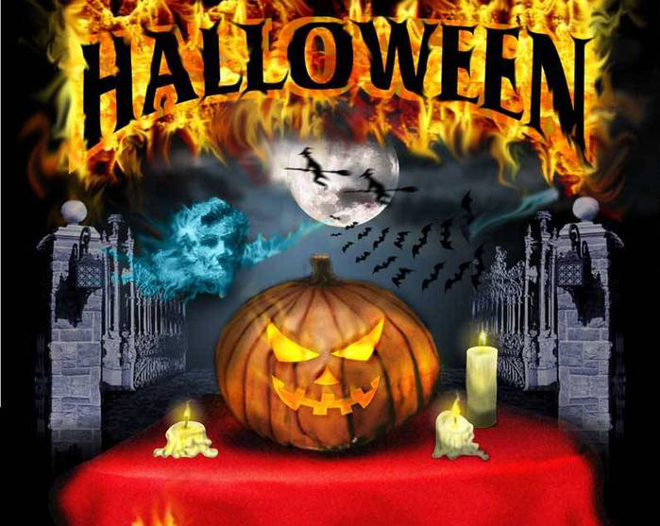
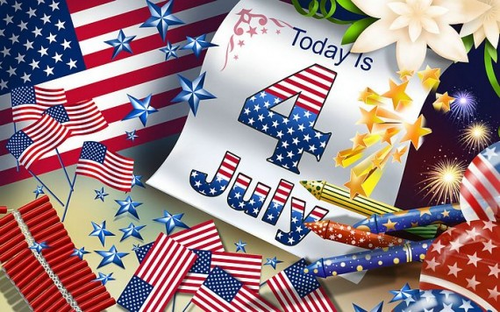
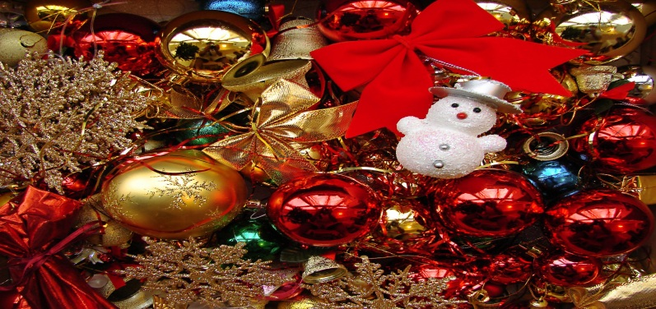
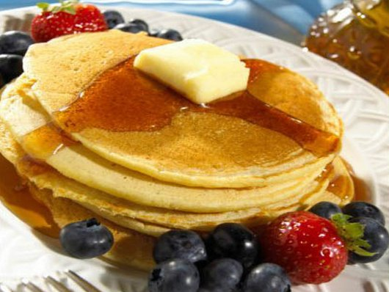
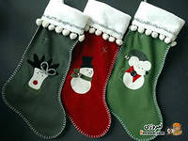
Traditions
Halloween
American Independence Day
St.Patrick̍s Day
New Year Day
Maslenitsa
Christmas

Slide 10
The fourth task is Famous People.
He is a Russian poet. He is very famous.
He invented a telephone.
He wrote “The Adventures of Tom Sawyer”
He was a sea admiral. He won the Battle for Trafarlgar.
He is a British scientist. He is called a Father oh Electricity.

Slide 11
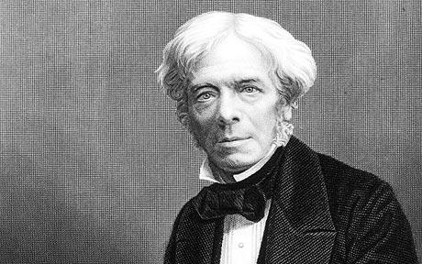
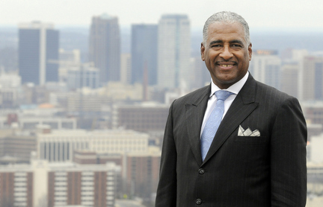
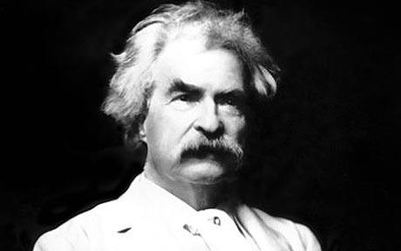
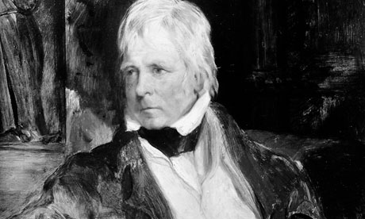
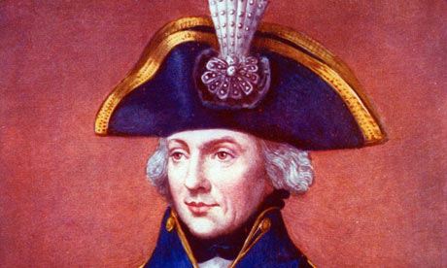
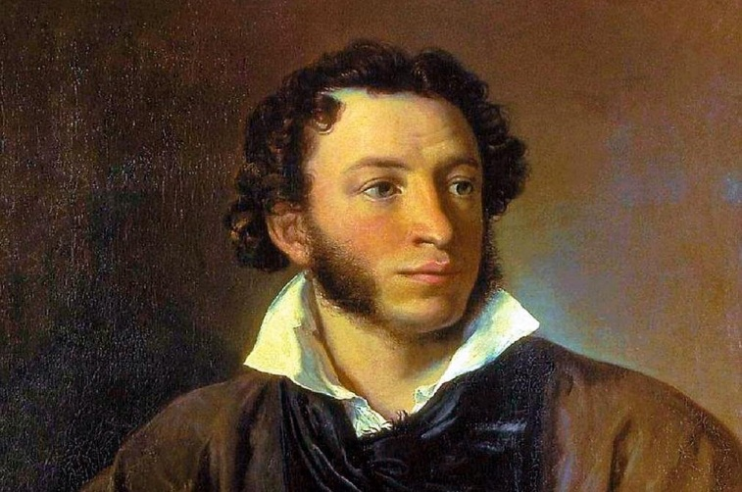
Famous people
M.Faradey
A.Bell
M.Twain
W.Scott
Admiral Nelson
A.Pushkin

Slide 12
The second round is Listening.
You should listen to speakers and do tasks.
You should find the headings of the text and match them.
One is extra.
Ramadan
Halloween
Thanksgiving Day
New Year
Mother’s Day
Easter
Christmas

Slide 13
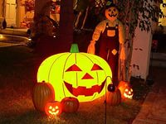
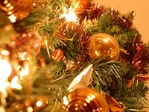
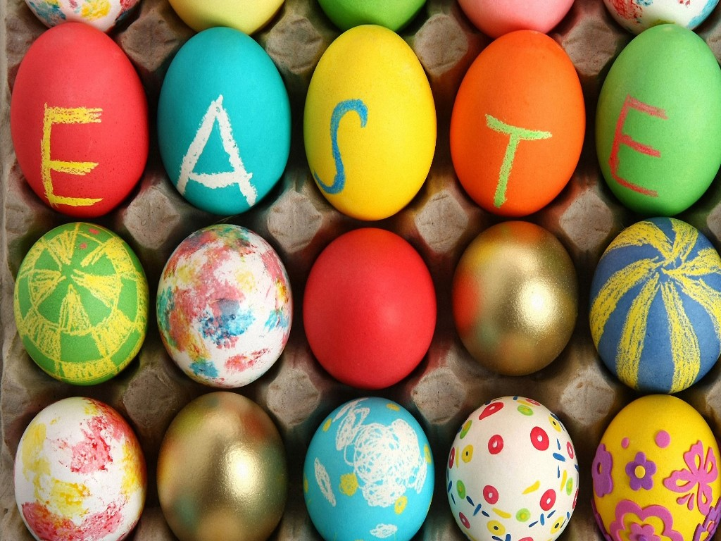
Traditions
1. Ramadan
2. Halloween
3. Thanksgiving Day
4. New Year
5. Mother’s Day
6. Easter
7. Christmas
A | B | C | D | E | F

Slide 14
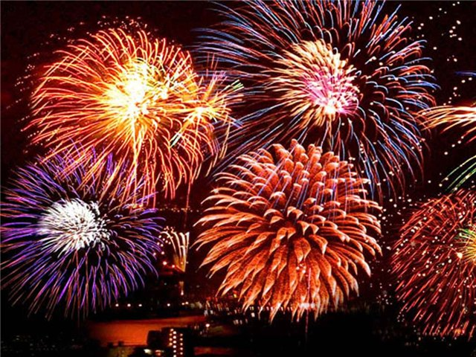
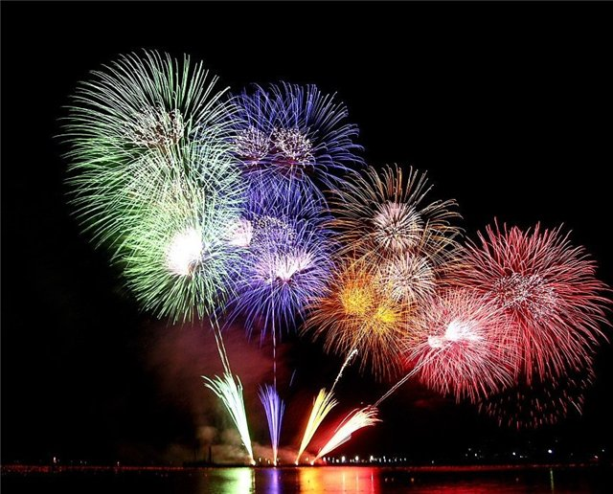
Personal letter
The third round
… My friends and I are doing a project about Russian traditions. I have heard about Victory Day. When do Russians celebrate Victory Day? How do they celebrate it? Is it a great holiday for a Russian nation? I am planning to visit Moscow.
- A letter to Paul
- Answer his questions
- Ask 3 questions about his trip to Moscow

