Slide 1
Урок английского языка по теме «At the doctor» 6 класс
Дружина Марина Владимировна
МОУ Романовская СОШ
Учитель английского языка
2015

Slide 2
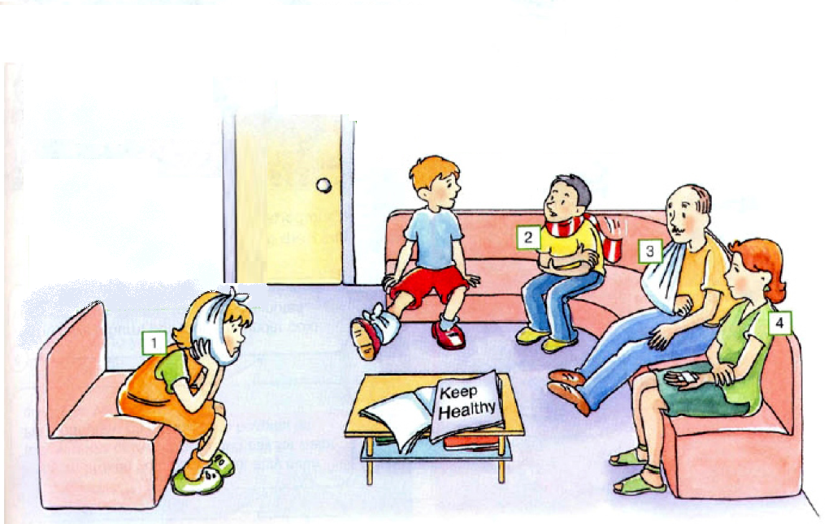
At the doctor

Slide 3
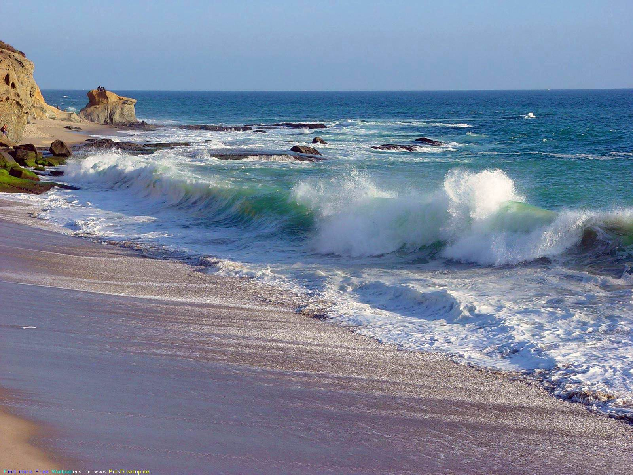
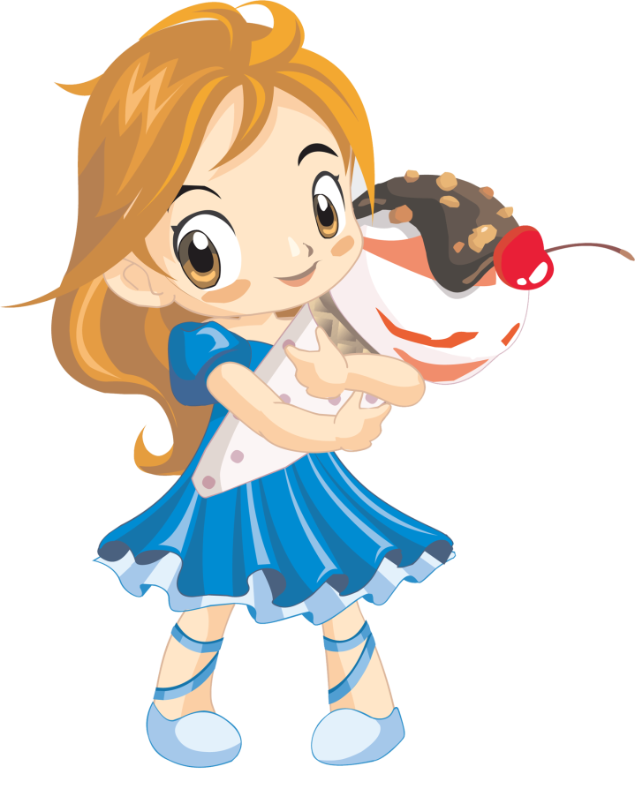
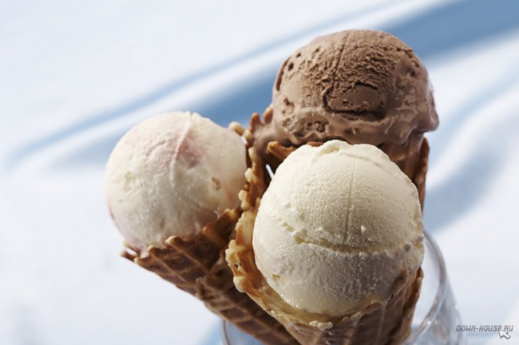
Why is Ann ill?
She has eaten four big ice creams

Slide 4
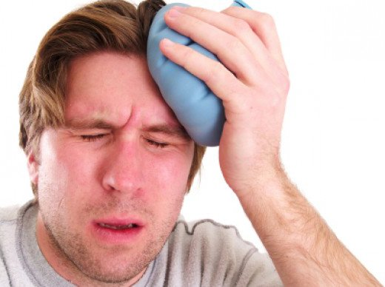
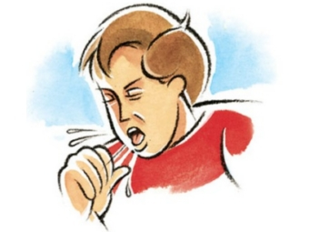
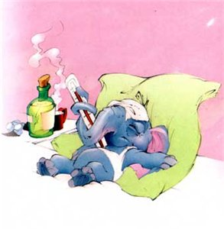
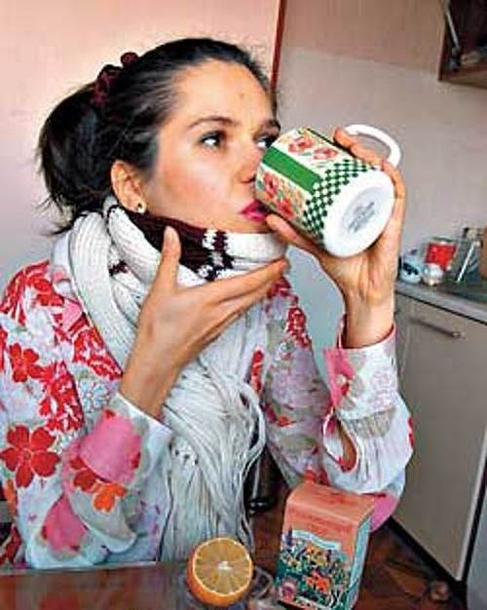
What were Ann’s problems?
She had a headache
She had a cough
She had a fever
She had a sore throat

Slide 5
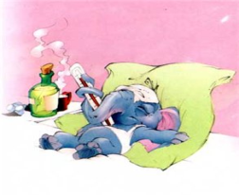
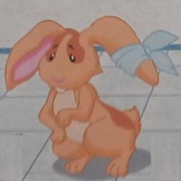
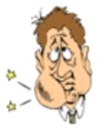
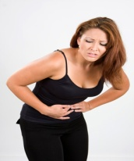
CROSSWORD PUZZLE
 |  | 1
 | 2 |  |  |  |  | 3
 |  |  |  |  |  |  |  |  | 5
 | 6
4
 |  |  | 7
1
2
3
4
5
6
7
Sore throat
Earache
Headache
Stomachache
Fever
Toothache
Cough

Slide 6
CROSSWORD PUZZLE
 |  | 1.F
 |  | E
 |  | V
 | 2.H | E | A | D | A | 3.C | H | E
 |  | R |  |  |  | O |  |  | 5. E
 | 6. T |  |  |  |  | U |  |  | A
 | O |  |  |  |  | G |  |  | R
4. S | O | R | E |  | T | H | R | O | A | T
 | T |  |  |  |  |  |  |  | C
 | H |  | 7. S | T | O | M | A | C | H | A
 | A |  |  |  |  |  |  |  | E
 | C
 | H
 | E
1
2
3
4
5
6
7
 |  | 1.F
 |  | E
 |  | V
 | 2.H | E | A | D | A | 3.C | H | E
 |  | R |  |  |  | O |  |  | 5. E
 | 6. T |  |  |  |  | U |  |  | A
 | O |  |  |  |  | G |  |  | R
4. S | O | R | E |  | T | H | R | O | A | T
 | T |  |  |  |  |  |  |  | C
 | H |  | 7. S | T | O | M | A | C | H | C |  | H | E
 | A |  |  |  |  |  |  |  | E
 | C
 | H
 | E
Sore throat
Earache
Headache
Stomachache
Fever
Toothache
Cough

Slide 7
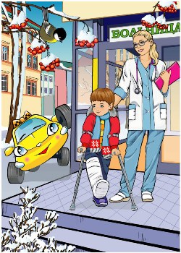
Are these sentences same?
He broke his leg last week.
Он сломал ногу на прошлой неделе.
He has broken his leg this week.
Он сломал ногу на этой неделе.

Slide 8
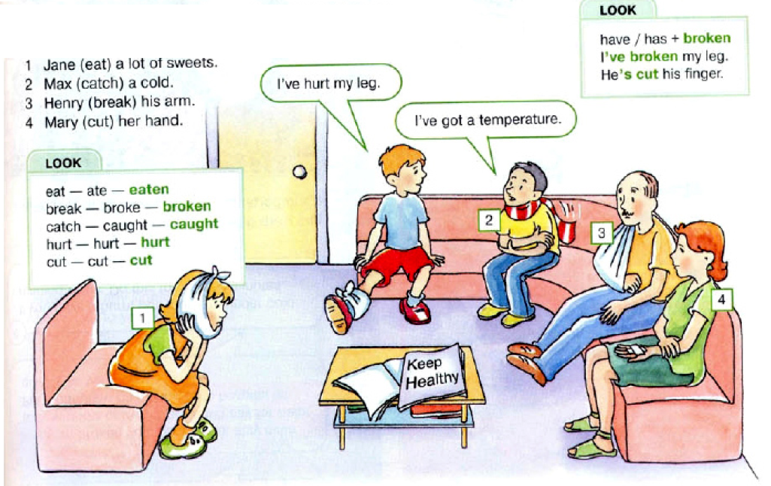
The Present Perfect tense

Slide 9
READ AND COMPLETE THE CONVERSATION
Hello. What’s the matter?
I don’t feel well. I’ve (1)______my leg and I’ve (2)_______my arm.
Show me. Where?
Oh, doctor. Don’t touch it, please.
Yes, mmm, your leg is OK but I’m afraid you’ve (3)______your arm. You should have an X-ray first.
Thank you, doctor.

Slide 10
READ AND COMPLETE THE CONVERSATION
Hello. What’s the matter?
I don’t feel well. I’ve (1)_broken_ my leg and I’ve (2)_hurt_my arm.
Show me. Where?
Oh, doctor. Don’t touch it, please.
Yes, mmm, your leg is OK but I’m afraid you’ve (3)_broken_your arm. You should have an X-ray first.
Thank you, doctor.

Slide 11
ФИЗКУЛЬТМИНУТКА

Slide 13
BOARD GAME «TELL ME»

Slide 14
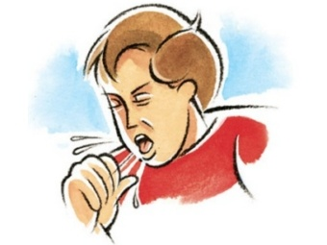
 |  | When did you ride a bike? |  | Have you ever cooked a big cake? |  |  |  | Go forwards 3 spaces
Have you ever drunk hot chocolate? |  | Go back 3 spaces |  | What did you do in the evening yesterday? |  | Have you ever been to London?
What did you read yesterday? |  | Go forwards 3 spaces |  | Have you ever ridden a horse? |  | When did your parents buy a car? |  | Go back 2 spaces
 |  | Have you ever slept all day along? |  | Start again |  | Have you ever had a headache? |  | Have you ever hurt your leg?
Go forwards 3 spaces |  | Who cooked your healthy breakfast yesterday? |  | Have you ever had a toothache?
START
FINISH
a) should take tablets and stay in bed
b) has eaten a lot of ice cream
c) has eaten a lot of sweets
d) has caught a cold
e) should drink a lot of tea with lemon
f) should clean teeth every day

Slide 15
HOMEWORK
Workbook
exercise 4 on page 58

