Slide 1
Christmas in Great Britain: customs and traditions

Slide 2
On the 25th of December people in many countries celebrate Christmas. The word “Christmas” comes from the words “Christ’s Mass” that is the celebration of the birth of Jesus Christ. This holiday means the beginning of the New Year and the new life. For many people it is the most important festival of the year. It’s time of love and happiness.

Slide 3
On this day people celebrate the birth of Jesus Christ, the Son of God. The birth took place in a stable – the place, where animals lived. Shepherds from the fields surrounding Bethlehem were told of the birth of Jesus by angels, and they were the first to see the Child.

Slide 4
Three wise men, they were kings, visited the infant Jesus in the stable. In a land far away from Judea they saw a new star in the sky. They understood a new star meant someone special was born. They decided to follow the star and find the Baby. These wise men wanted to worship Jesus and to give Him wonderful gifts.

Slide 5
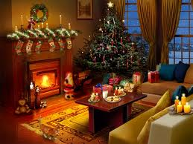
In general, British people get prepared for this holiday very carefully. They decorate their houses in the traditional way. Christmas trees are set up in houses, in the streets and churches. The outside of houses may be decorated with lights and illuminated Christmas figures. Other traditional decorations include bells, candles, stockings, wreaths and angels.

Slide 8
The Germans are believed to be the first to use the Christmas tree in their celebrations and Martin Luther was the first to place a star on the top of the tree. This star represents the star which appeared over the stable in which Christ was born. From Germany this custom was introduced to Britain while Queen Victoria ruled the country. It happened in the 19th century.

Slide 9
Every year a beautiful Christmas tree stands on Trafalgar Square. People of Norway send a Christmas tree to people of Great Britain every year. Norwegian people do it in thanks for Britain’s support during the Second World War. It comes to Britain by the sea and already decorated in Norwegian style and with 500 lights.

Slide 10
The traditional colors of Christmas are green and red. White, silver and gold are also popular. Red symbolizes the blood of Jesus, which was shed in his crucifixion, while green symbolizes eternal life. Besides the Christmas tree, holly and mistletoe are used to decorate the house. Mistletoe is hung over doors. It is said that the girl who was not kissed under it at Christmas wouldn’t get married that year.

Slide 11
The following tradition connected with Christmas is gift giving. Children believe that Santa Claus gives presents to them. On the eve of Christmas children hang their stockings, so that Santa could put presents into them, and if the child didn’t behave properly Santa Claus can put in the stockings a piece of coal.

Slide 12
Santa Claus got its name from a man known as Saint Nicholas. Nicholas was Bishop of Myra, in modern day Turkey, during the 4th century. He was noted for the care of children, generosity, and the giving of gifts. He gave his wealth to the poor and often to children.

Slide 13
The modern popular image of Santa Claus was created in the USA, and particular in New York. A new image of Santa Claus created the artist named Nast in 1863.

Slide 14
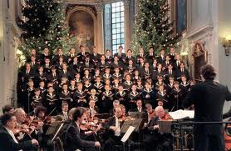
Carol singing is an essential part of Christmas. No church or school is without its carol service. Before Christmas groups of singers perform traditional Christmas songs or carols in the streets, shops and squares. They collect money for charity.

Slide 15
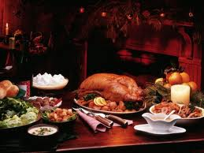
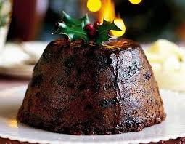
Christmas dinner usually consists of roast turkey, sometimes with roast beef or ham. There is also cranberry sauce, bread sauce, roast potatoes, vegetables, Brussels sprouts, parsnips and carrots, Christmas pudding and mince pies.

Slide 16
After the meal the members of the family sit down in front of the television for traditional Christmas speech of the British Monarch.

Slide 17
Conclusion
In our opinion working on this problem we have received additional knowledge about Christmas in Great Britain and customs and traditions which are connected with this holiday. It has helped us to expand our lexical stock and our general outlook. We have found interesting information about some customs and traditions. And the educational complex doesn’t contain this information. We think that this work will be useful as for students as well for teachers.

