Slide 1
Healthy lifestyle

Slide 2
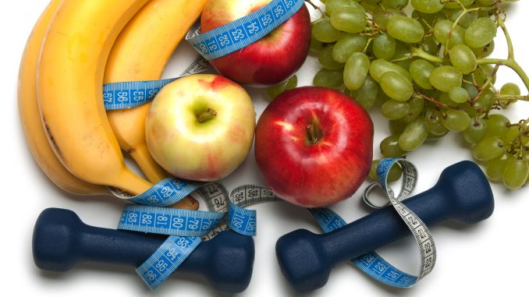
I would like to tell about a healthy lifestyle and its advantages for man.

Slide 3
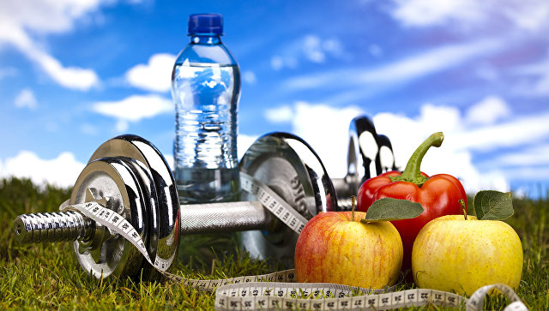
A healthy lifestyle is very fashionable nowadays. But it is not only popular, it is also useful for our organism!

Slide 4
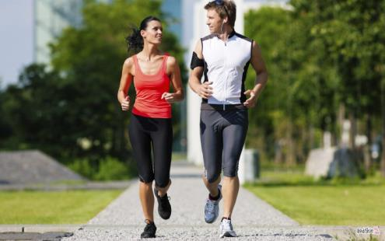
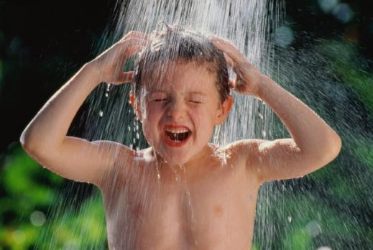
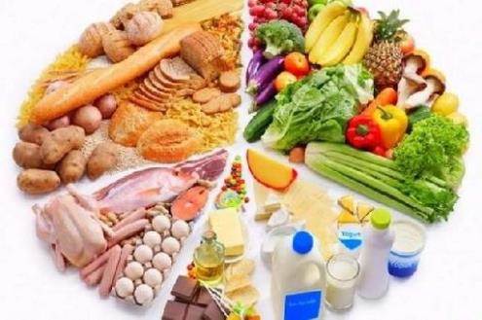
People, who lead a healthy lifestyle, follow come rules:
go in for sports
walk frequently in the open air
temper
keep to a day regimen
eat healthy food

Slide 5
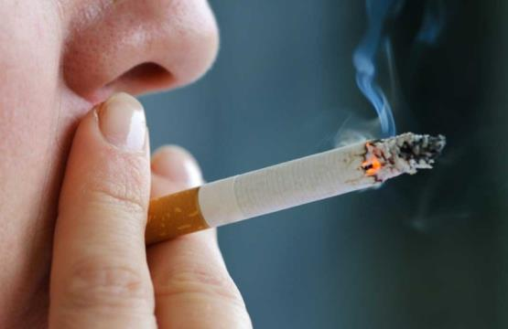
Bad habits and a healthy lifestyle are incompatible.

Slide 6
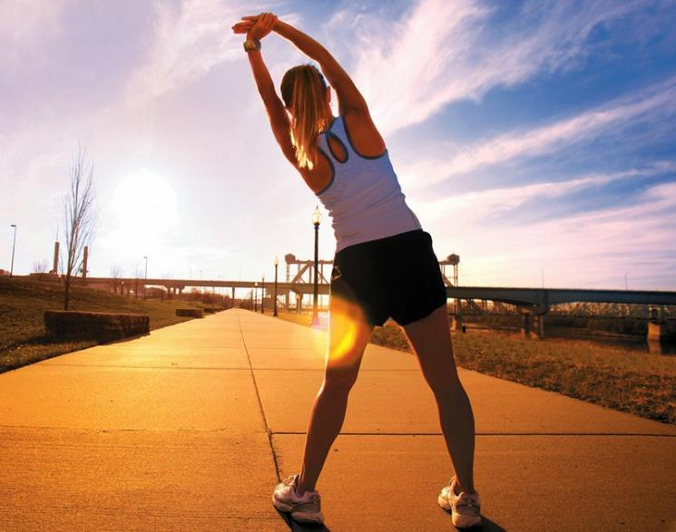
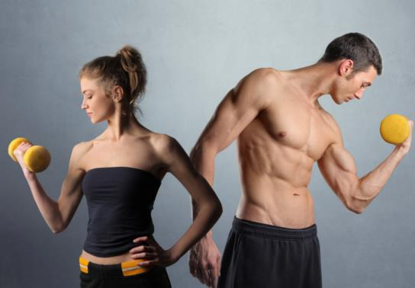
Perhaps, sport occupies the most important place in a healthy lifestyle. You can do exercises in the morning and you can practice various sports. The most important thing is to choose for you something real. You should really start something.

Slide 7
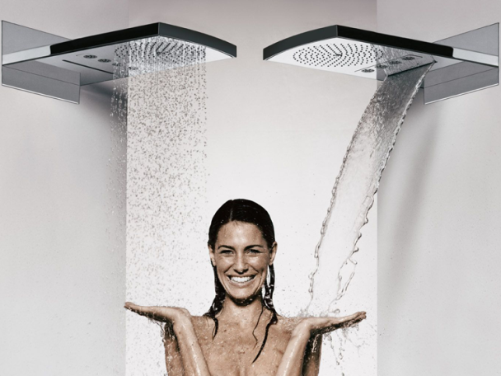
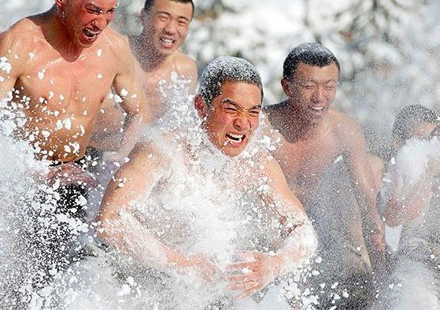
Tempering also takes an important place in maintaining the vital tonus. It includes dousing with cold water, a contrast shower, rubbing with snow and other procedures. Tempering supports the vascular tone.

Slide 8
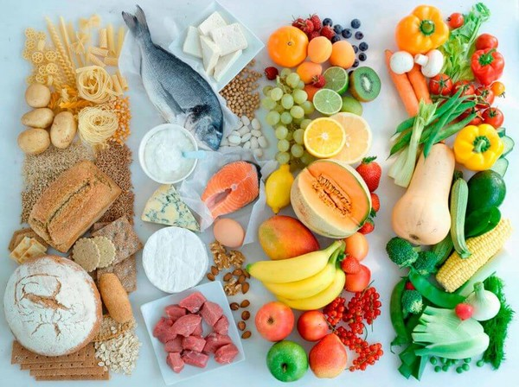
We shouldn’t forget about healthy eating either. Proteins, fats and carbohydrates should be balanced.

Slide 9
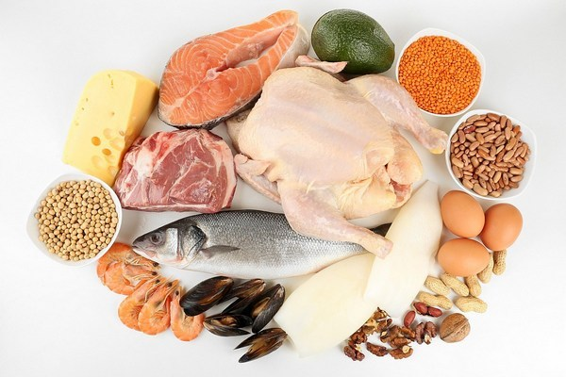
Proteins are the «bricks» that make up the body’s cells.

Slide 10
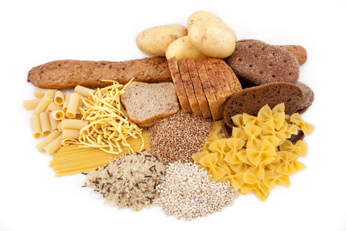
Your body needs fats that reserve energy and calories.

Slide 11
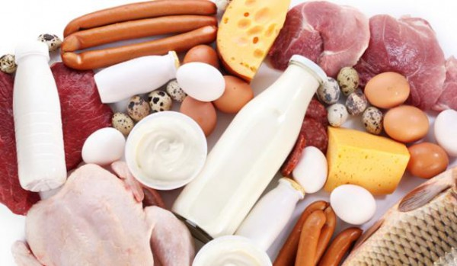
Carbohydrates are the main supplier of energy life.

Slide 12
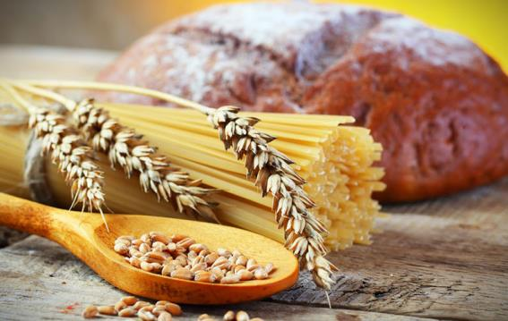
Dietary fibers stimulate good digestion, protect the organism from dietary carcinogens and help to prevent many diseases. That’s why it is not recommended to limit you in products, which contain proteins, fats, and carbohydrates.

Slide 13
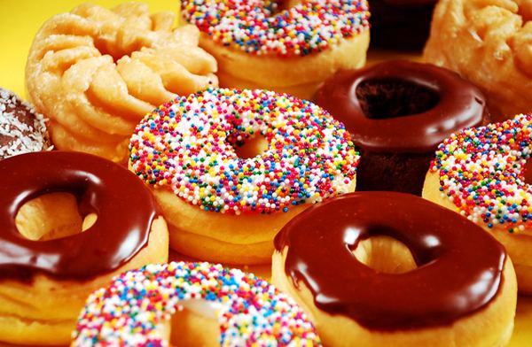
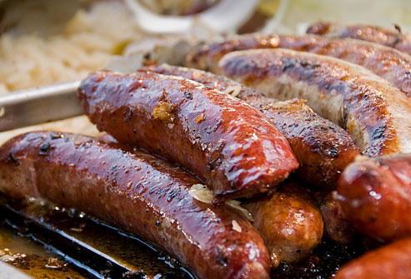
But it is necessary to limit yourself in sweets, salt, spicy and fried food, and also strong carbonated drinks.

Slide 14
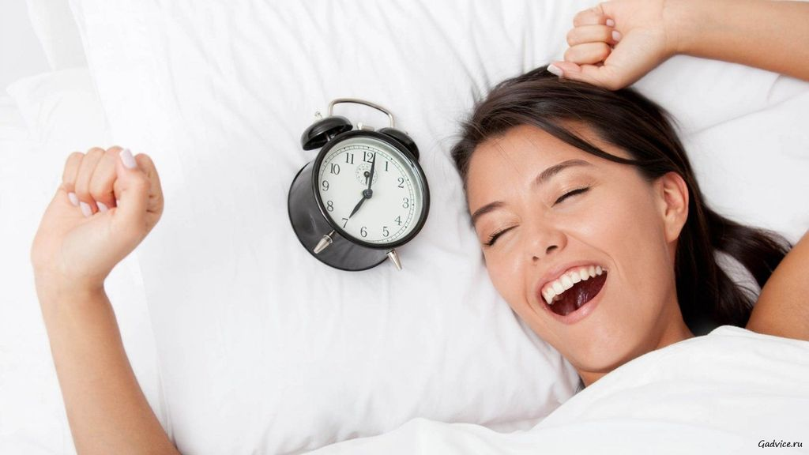
It is also important to keep to a day regimen. We should go to bed and get up at approximately the same time.

Slide 15
And, of course, it is necessary to spend more time outdoors, whether it is winter or summer.

Slide 16
So, if we follow a healthy way of life, we will live a long and beautiful life.

