Slide 1
Phrasal Verb LOOK
Учитель: Захарьина Ольга Валерьевна
МБОУ «Лицей №17» г. Северодвинска, Архангельской области
2016

Slide 2
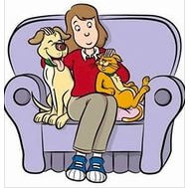
look after
1 look after sb: to spend time with someone and make sure that they are safe and have the things they need
(присматривать, ухаживать, заботиться )
e.g. Her husband looks after the children while she's at work. The doctors there are very good, and I'm sure you'll be well looked after.
2 look after sth: to keep something in good condition or make sure that it is safe (беречь, присматривать за чем-либо, стеречь)
e.g. Who is responsible for looking after the gardens?
Can you look after my bags while I go up to the bar?

Slide 3
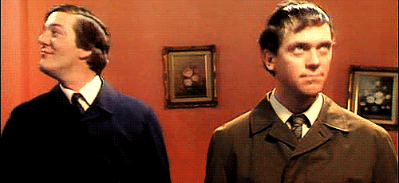
look about/around
to look about/around = walking around the place looking at the various things there
(оглядываться вокруг, озираться)
e.g. She came into the room, looked around, then went out again.
2. to look about/around = to make enquiries before choosing
(подыскивать, присматривать)
e.g. She spent several months
looking about/around,
trying to find a better job.

Slide 4
look at
1. look at smb/smth = direct one’s eyes toward something;
(смотреть на кого-либо, что-либо, взглянуть, посмотреть)
e.g. Don’t look at me like that! What are you looking at?
2. look at smth = to consider, examine
something;
(рассматривать, изучать, проверять).
e.g. The company is currently looking at
ways In which it can improve its image.

Slide 5
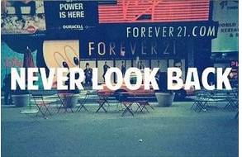
look back
look back = a) to turn back and look (оглядываться назад)
e.g. Looking back, I wish I hadn't said some of those things.
b) look back on = remember, reflect on / consider something in the past. (обращаться к прошлому (мысленно), вспоминать)
e.g. When they looked back on their many years together, they realized that their marriage had been a very happy one.
2. look back = not to move ahead
(не идти вперед, останавливаться)
e.g. Since Jim got started in business, he
hasn’t looked back.

Slide 6
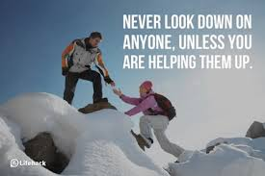
look down on
1. look down on smb = to think you are better than somebody else, to despise, see as inferior (opp: look up to)
(смотреть свысока, относиться презрительно, высокомерно)
e.g. Mary looked down on her classmates because she was better dressed than they were.
Women have grown tired of being looked down on by employers.
2. to look down on smth – to think that something is not very good
(не одобрять)
e.g. The school looks down on such
behaviour.

Slide 7
look for
to look for = to try to find someone or
something, to seek or search for
(искать )
e.g. Fred spent all day looking for a job.
The police and the villagers are out in the woods, looking for the missing child.
2. to look for = to expect
(рассчитывать, ожидать)
e.g. The frost killed many oranges, and housewives can look for an increase in their price.
Bob wouldn't go for a ride with the boys because he was looking for a phone call from Julia.

Slide 8
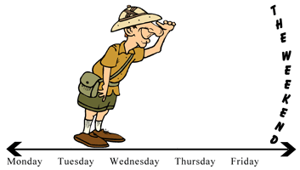
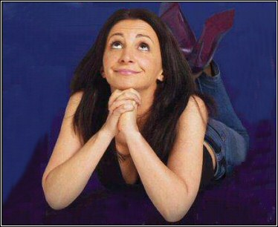
look forward to
to look forward to = to be excited and happy about something good that is going to happen, to anticipate (with pleasure)
(предвкушать, с нетерпением ждать )
e.g. Jim looked forward to the day
when he could retire.
I'm looking forward to their visit.

Slide 9
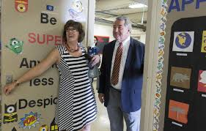
look in (on sb)
to look in (on smb) = to pay a short visit to smb
(заглянуть (в гости)
e.g. I I'll look in on Francesca when I'm in Rome.
I thought I'd look in on you while I was passing.

Slide 10
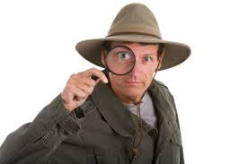
look into
to look into smth = to try to find out the (acts about something such as a crime, a problem, or an accident, to investigate
(расследовать)
e.g. The police are look­ing into last night's robbery.
The committee must look into what hos­pital conditions exist for children.
2. look into sth: to find out more about something by getting all the necessary information
(детально изучать, разобраться)
e.g. It sounds like an interesting idea
for a holiday – I'll definitely look into it.

Slide 11
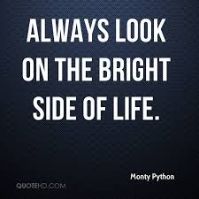
look on
to look on = to observe as a spectator, to watch something while it is happening but not take part in it or try to stop it
(рассматривать что-либо, наблюдать)
e.g. Everybody just looked on as the two men fought.
onlooker = someone who watches something while it happens, without being involved in it
(зевака, зритель, наблюдатель, свидетель)
e.g. A crowd of curious onlookers had gathered around the building.
2. to look on (upon) as = consider someone or something in a
particular way, to regard as
(относиться , иметь мнение о ком-то, о чем-то)
e.g. We've always looked on Jack as one of the family.

Slide 12
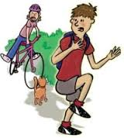
look out
1 look out for sb/sh = to look carefully and pay close attention in order to try to see someone or something
(выглядывать, высматривать)
e.g. We kept looking out for him, but there was no sign at all.
2. Look out! = Watch out! = be careful, pay attention; use this to warn someone that they are in danger and that they must do something to avoid it
(быть настороже)
e.g. Look out, there's a black widow
spider on the wall.

Slide 13
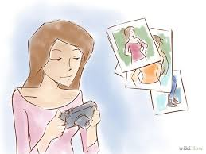
look over
look over = to quickly examine someone or something, to see if there is anything wrong with them or to see what they are like
(осмотреть, просмотреть)
e.g. The girl looked him over coldly and laughed.
2. to look over = to examine carefully, go through
(изучать, осматривать, исследовать)
e.g. When I'm camping, I look my shoes over
before I put them on.

Slide 14
look through
look through smth = to look at quickly, to read something quickly
( пробежать (глазами)
e.g. Can you look through the report and tell me what you think of it?
Looking through a magazine in the doctor's waiting room, I found a photograph of my own daughter's wedding.
2. look through smth = to study sth carefully,
(внимательно изучать, тщательно просматривать)
e.g. I looked through the letter again but could find no sign of anxiety.
3. look through smb = to look at someone and seem not to notice them or pretend not to recognize them, not to notice smb
( в упор не видеть)
e.g. I said good morning but she looked straight
through me and walked on.

Slide 15
look up
1. to look smth up = to try to fund information about something in a book , in a list, etc.
(искать, смотреть в справочнике, словаре и т.д.)
e.g. if you don’t know what the word means look it up in the dictionary.
look up to smb = to admire or respect someone a
lot. (or example because they are older or more
experienced than you (opp: look down on)
(почитать, уважать, обожать к-л)
e.g. The students really looked up to Mr Jones.
He looks up to his father.

Slide 16
Match the phrasal verb in column A with their meanings in column B
look after
look back on
look down on
look for
look forward to
look into
look on
look up to
to remember nostalgically
see as inferior
anticipate with pleasure
take care of
observe as a spectator
to seek or search for
respect, admire someone
investigate
D
A
B
F
C
H
E
G

Slide 17
Solve the crossword
7. to try to find information about something
in a book , in a list, etc.
6. to look at quickly, to read something quickly
5. be careful, pay attention
1. to think you are better than somebody else
3. direct one’s eyes toward something
4. to examine carefully
2. to pay a short visit to smb
 |  | 4 |  |  |  |  | 6
1
 |  |  |  | 5
 |  |  | 2
 |  |  |  |  |  |  |  |  | 7
 |  |  |  |  | 3
l
o
o
k
o
v
e
r
l
o
o
k
t
h
r
o
u
g
h
l | o | o | k |  | d | o | w | n |  | o | n
l | o | o | k |  | i | n
l
o
o
k
o
u
t
l
o
o
k
u
p
l | o | o | k |  | a | t

Slide 18
Fill in the gaps with the necessary preposition or adverb.
after
Mother was well looked .......... in hospital.
I am looking ……… a suitable hotel; can you suggest one?
If you don't know some of the dates, look them ……… in the history book.
Go and find a taxi and I'll look ………. the suitcases.
Look ..….... the picture. What's in it?
I looked …………. the test again but couldn't find any mistakes.
Mary and I are looking ………… a new house for our family.
Looking ……….. on the older days, I'm sure we were much happier then.
for
up
after
at
through
for
back

Slide 19
Match the two halves of each dialogue.
1. I don't know what this word means.
2. Have you found somewhere to live yet?
3. What's happening to your dogs while you're away on holiday?
4. They're so snobbish, aren't they?
5. Any news about your stolen videorecorder?
6. Didn't Mandy say "Hello" when she saw you?
7. I wonder if Sandra's feeling any better.
8. Only two more weeks and then we're on holiday.
A I know. I'm really looking forward to having a break.
В No. She looked straight through me and pretended I wasn't there.
С Yes. They look down on people like you and me.
D Well, look it up in a dictionary.
E We've looked round a few flats but they're all too expensive.
F The police are looking into it but they aren't very hopeful.
G My mother-in-law's looking after them.
H I'll look in on the way home and see how she is.
D
E
G
C
F
B
H
A

Slide 20
Replace the underlined words in these sentences with the correct form of one of the phrasal verbs (One is extra): look over look on look into look through look up look out
The police are investigating the crime.
If you can’t remember the number, you can always find it in the telephone book.
If you are not careful , you are going to have an accident one day.
Can you please read the text quickly and find all the phrasal verbs.
He merely watched and did nothing to stop the fighting boys.
looking into
look it up
don’t look out
look through the text
looked on

Slide 21
Replace the underlined words in these sentences with the correct form of one of the phrasal verbs (One is extra): look over look on look out look up on look after
6. Who takes care of the kids when you go out in the evening?
7. It was terrible! While the little old lady was being mugged, several passers-by just stood there watching !
8. Watch out! The Director is coming!
9. I regard you as my own son.
10. You should examine the property carefully before you decide to buy it.
looks after
looking on
Look out
look up on
look over

Slide 22
Complete these sentences using the correct form of the phrasal verbs in each space
I usually …………………... a book before deciding whether to read it.
Every child needs someone to …………..... and copy.
We must ……… the school …..…….. before sending our son there.
You can …………… her telephone number in the book.
……...........! The roof is falling!
What results are you ………………..?
If you …………………your new shoes they will last longer.
I’ve spent hours in the shops ………………… a suitable dress.
look through
look up to
look
over
look up
Look out
looking for
look after
looking for

Slide 23
Литература
JOHN FLOWER. PHRASAL VERB ORGANISER with Mini-Dictionary. Editor: Jimmie Hill. LTP .LANGUAGE TEACHING PUBLICATIONS .114a Church Road, Hove BN3 2EB ISBN 0 906717 62 0 © LTP 1993 Reprinted 1993, 1995, 1996, 1997, 1998;
Longman Pocket Phrasal Verbs Dictionary for Intermediate-advanced learners . Pearson Education ESL, 2001;
Oxford Phrasal Verbs dictionary for learners of English. Oxford University Press, 2002;
Jake Allsop. Test your phrasal verbs. Pearson Education Limited. Edinburgh Gate. Harlow. Essex. CM20 2JE England and Associated companies throughout the world. ISBN13 .2002;
James Milton, bill Blake, Virginia Evans A Good Turn of Phrase. Advanced Practice in Phrasal Verbs and Prepositional Phrases. Express Publishing.2000;
Jenny Dooley -. Virginia Evans. Grammarway 4. Express Publishing.2000;
Кортни Р. Английские фразовые глаголы. Англо-русский словарь.- 2-е изд., стереотип.- М.: Рус. яз., 2000;
О.А. Волошина. Английский язык. Фразовые глаголы. Москва. «Живой язык» 2012;
С.В. Литвинов. Тесты по грамматике английского языка. Phrasal Verbs .- М.: АРКТИ, 2000.
Ссылки на картинки:
https://yandex.ru/images/search?source=wiz&text=look%20after%20picture&noreask=1&img_url=http%3A%2F%2Fi.ebayimg.com%2F00%2Fs%2FMTk1WDIwMA%3D%3D%2Fz%2F9ZwAAOxyBXNSYLgD%2F%24T2eC16d%2C%21ycFIdG3Ct9NBSYLgCK1bQ~~48_14.JPG&pos=1&rpt=simage&lr=10849 - look after
https://yandex.ru/images/search?source=wiz&text=look%20back%20picture&noreask=1&img_url=http%3A%2F%2Fwww.el-nacional.com%2Fescenas%2FThe-Walking-Dead-Latinoamerica-AMC_NACIMA20140103_0004_11.jpg&pos=8&rpt=simage&lr=10849 -look back
http://www.lovelylanguage.ru/images/stories/en/speaking/idioms/look-for-2.jpg - look for
http://ih.constantcontact.com/fs121/1102063729804/img/1118.gif - look forward to
https://encrypted-tbn0.gstatic.com/images?q=tbn:ANd9GcRe050XPiOG4gSlG9PU49KIgyNmeP_jVem-pI_WdA3857oYLGUApQ -look into
http://www.nutraingredients.com/var/plain_site/storage/images/publications/food-beverage-nutrition/nutraingredients.com/regulation/uk-busts-84-sports-supplements-for-dangerous-ingredients/6924883-1-eng-GB/UK-busts-84-sports-supplements-for-dangerous-ingredients.jpg -look into
http://t0.gstatic.com/images?q=tbn:ANd9GcQlyRAqRbdlU-0fnYe9gVIPkhlk2AIh_iId1hvrP0czgvY2bLIK -look in on
https://incloverblog.files.wordpress.com/2014/09/tcgmw.gif - look about
https://encrypted-tbn3.gstatic.com/images?q=tbn:ANd9GcSk-rNwf7wIqZl38fSllgYgA81lIxvJNEOHv6jHNFrL9pI5AwjO - look out
https://lh3.googleusercontent.com/Wd8DkK5JnHpxYtI2NegwVzxAUeQOTD07xskg_gdrxWDXfEWVUfIqWAvHxRyS2IZ0p8ApXw=s113 - look over
https://lh3.googleusercontent.com/H5eWoqE8k187vjEp1WfM06Fo2Y7n63_IF3untNvhjfc_gnyR3kAPFwBv9hPy8LIRAxl5=s127 - look through

Slide 24
Phrasal Verb LOOK
Учитель: Захарьина Ольга Валерьевна
МБОУ «Лицей №17» г. Северодвинска, Архангельской области
2016

