Slide 1
Inventions & discoveries | Where? | Books & Films | Cars | Made from/ of …
100 | 100 | 100 | 100 | 100
200 | 200 | 200 | 200 | 200
300 | 300 | 300 | 300 | 300
400 | 400 | 400 | 400 | 400
500 | 500 | 500 | 500 | 500

Slide 2
100 Inventions and discoveries
Who was the light bulb invented by?

Slide 3
100 Inventions and discoveries
What was invented by Thomas Edison?

Slide 4
200 Inventions and discoveries
Who were airplanes invented by?

Slide 5
200 Inventions and discoveries
What was invented by the Wright brothers?
5 см

Slide 6
300 Inventions and discoveries
Who was the telephone invented by?

Slide 7
300 Inventions and discoveries
What was invented by
Alexander Graham Bell?

Slide 8
400 Inventions and discoveries
Who was the Internet Explorer
invented by?

Slide 9
400 Inventions and discoveries
What was invented by Bill Gates?

Slide 10
500 Inventions and discoveries
Who was the law of relativity
invented by?

Slide 11
500 Inventions and discoveries
What was invented by Albert Einstein?

Slide 12
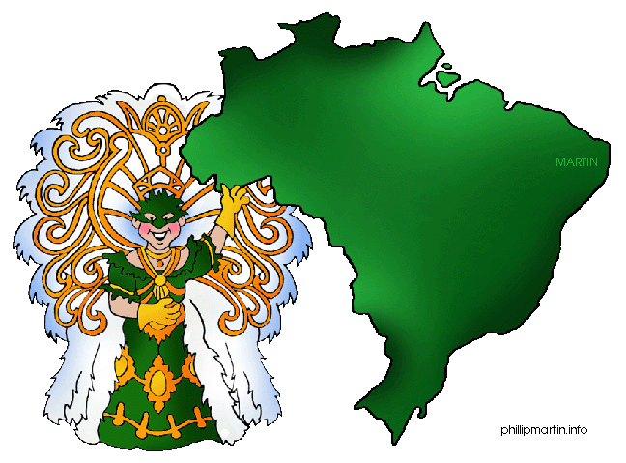
100 Where?
Where are bananas grown?

Slide 13
100 Where?
What is grown in Brazil?

Slide 14
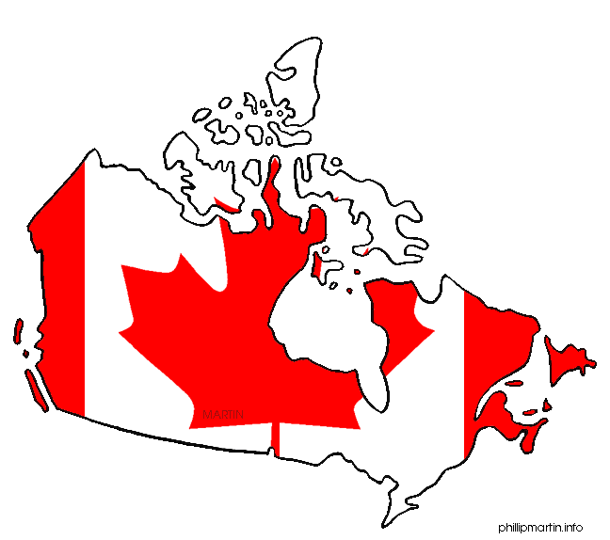
200 Where?
Where are apples grown?

Slide 15
200 Where?
What is grown in Canada?

Slide 16
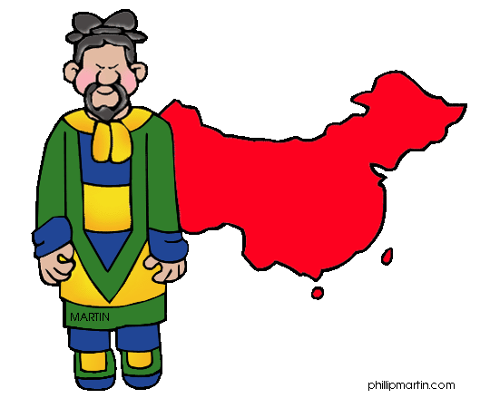
300 Where?
Where is rice grown?

Slide 17
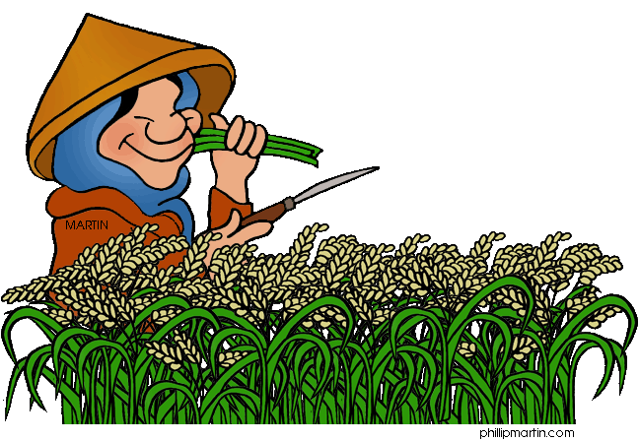
300 Where?
What is grown in China?

Slide 18
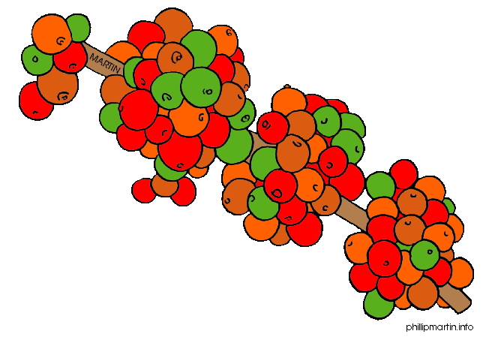
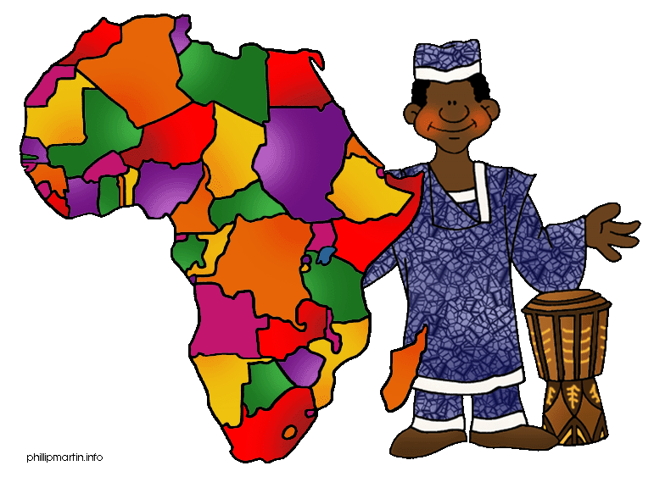
400 Where?
.
Where are coffee beans grown?

Slide 19
400 Where?
What is grown in Africa?

Slide 20
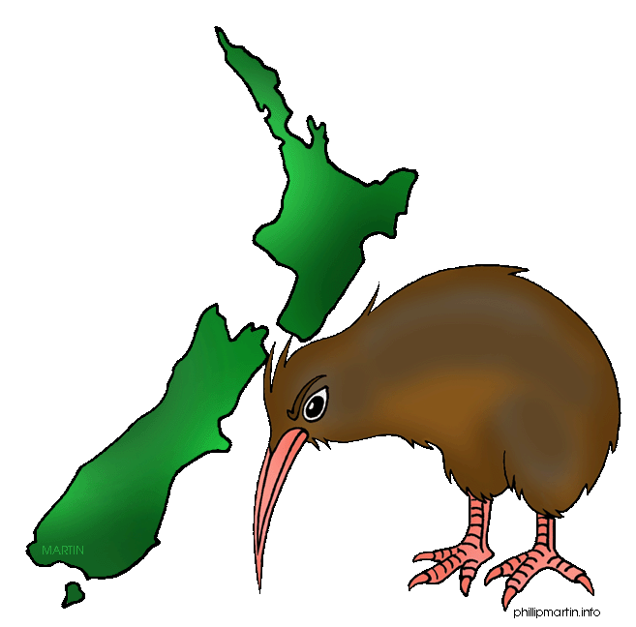
500 Where?
Where are kiwis grown?

Slide 21
500 Where?
What is grown in New Zealand?

Slide 22
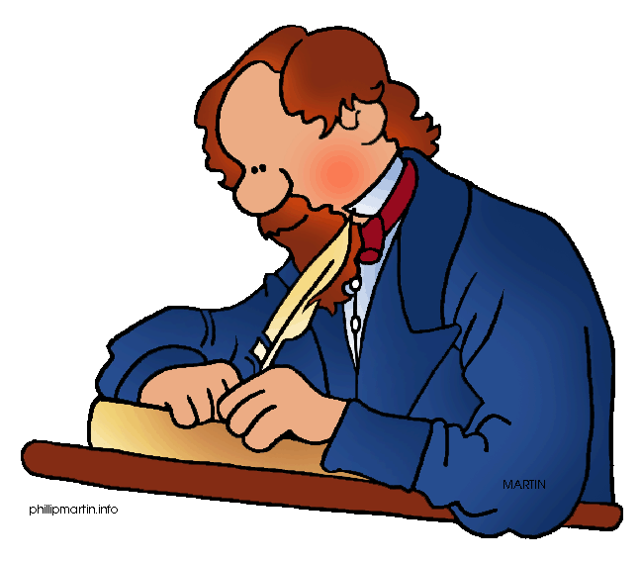
100 Books and Writers
Who was “Oliver Twist” written by?

Slide 23
100 Books and Writers
What was written by Charles Dickens?

Slide 24
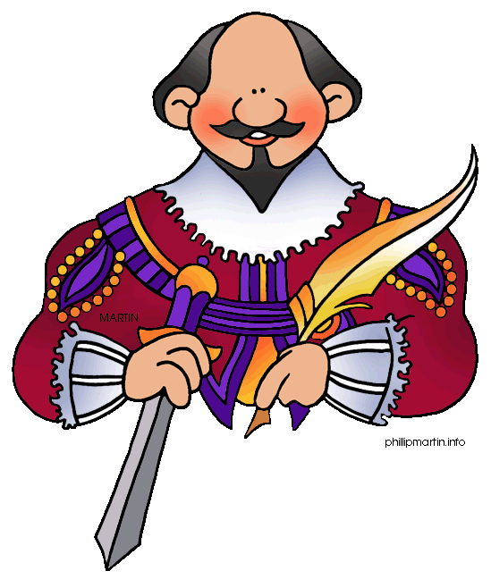
200 Books and Writers
Who was “Romeo and Juliet” written by?

Slide 25
200 Books and Writers
What was written by
William Shakespeare?

Slide 26
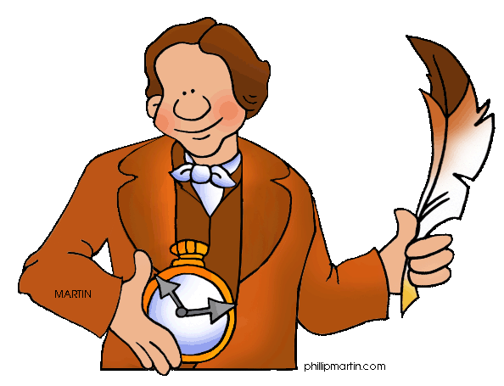
300 Books and Writers
Who was “Alice in Wonderland”
written by?

Slide 27
300 Books and Writers
What was written by
Lewis Carroll?

Slide 28
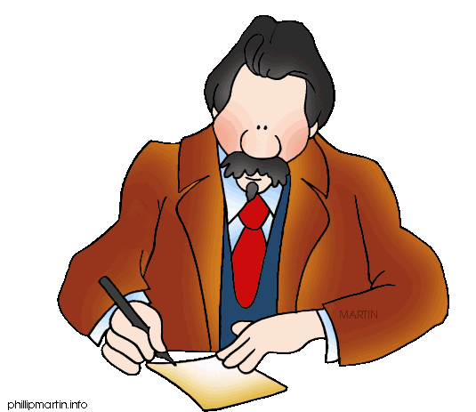
400 Books and Writers
Who was “Treasure Island”
written by?

Slide 29
400 Books and Writers
What was written by
Robert Louis Stevenson?

Slide 30
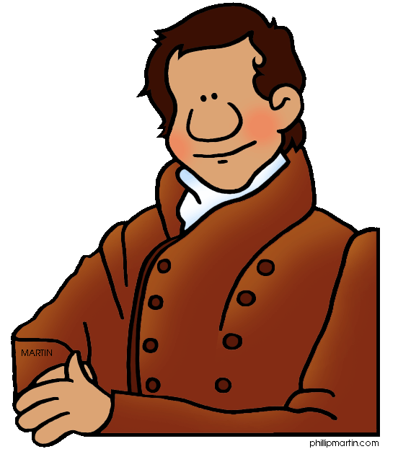
500 Books and Writers
Who was “The Last of the Mohicans”
written by?

Slide 31
500 Books and Writers
What was written by
James Fenimore Cooper?

Slide 32
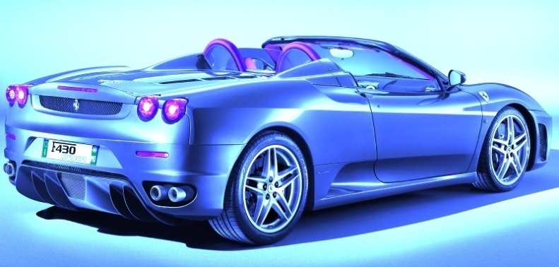
100 Cars
Who was a sports car built by?
Porsche
Hyundai
Toyota

Slide 33
100 Cars
What car was built by Porsche?

Slide 34
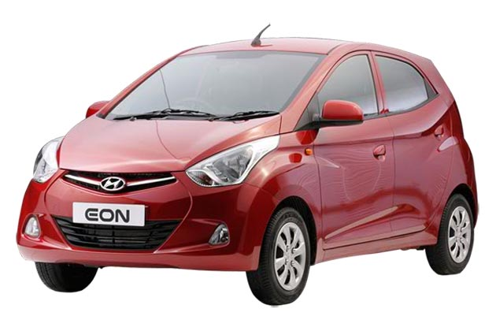
200 Cars
Who was a compact car built by?
Porsche
Hyundai
Toyota

Slide 35
200 Cars
What car was built by Hyundai?

Slide 36
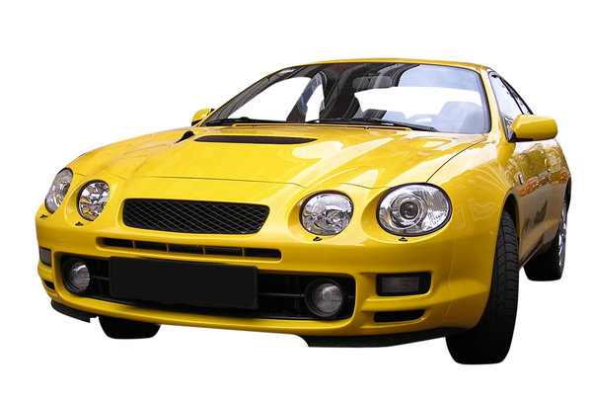
300 Cars
Who was the yellow sports car built by?
Porsche
Hyundai
Toyota

Slide 37
300 Cars
What car was built by Toyota?

Slide 38
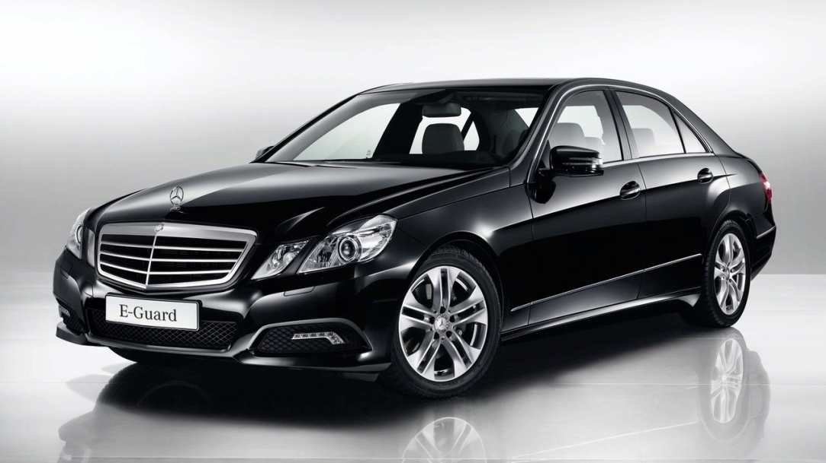
400 Cars
Who was this car invented by?
Mercedes
Ford
Benz

Slide 39
400 Cars
What car was invented by Benz?

Slide 40
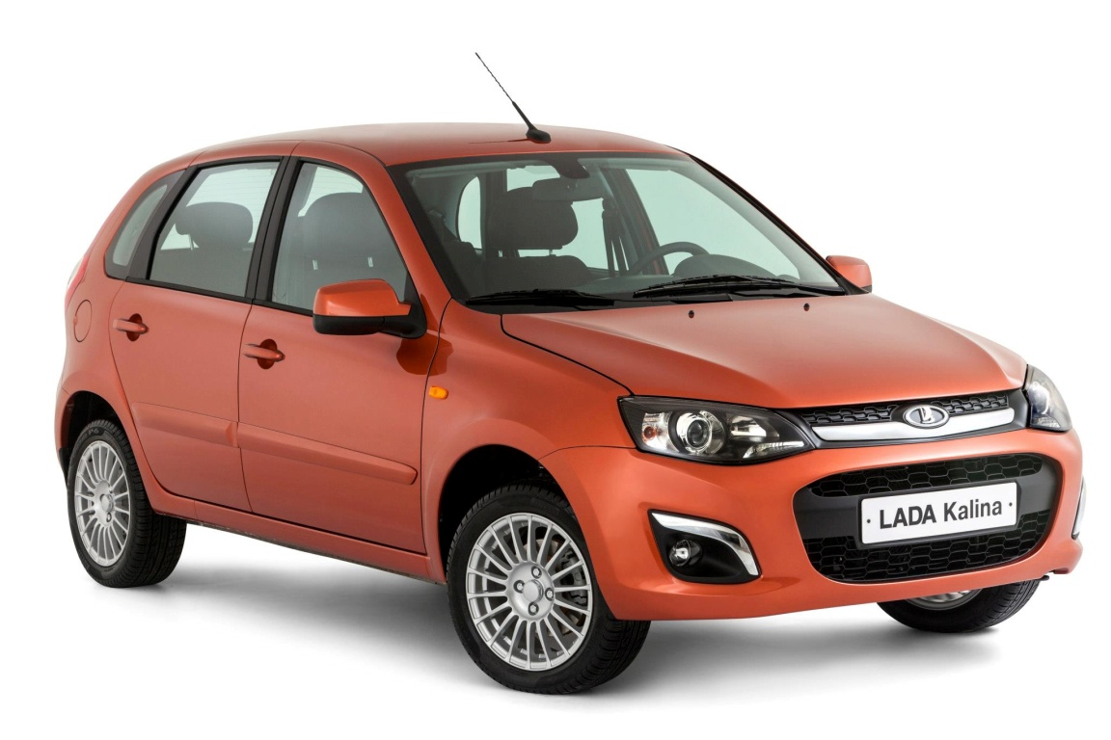
500 Cars
Who was this car produced by?

Slide 41
500 Cars
What car was produced by AvtoVAZ?

Slide 42
100 Made from/ of
What is pop corn made from?

Slide 43
100 Made from/ of
What is made from corn?

Slide 44
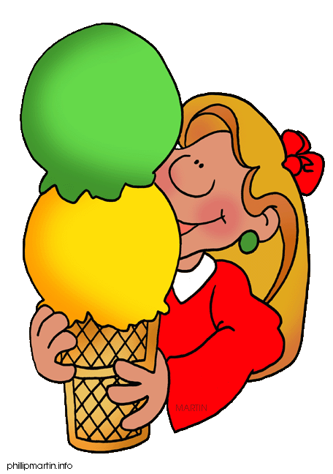
200
Made from/ of
What is ice cream made from?

Slide 45
200 Made from/of
What is made from milk?

Slide 46
300
Made from/of
What are T-shirts made of?

Slide 47
300 Made from/of
What is made of cotton?

Slide 48
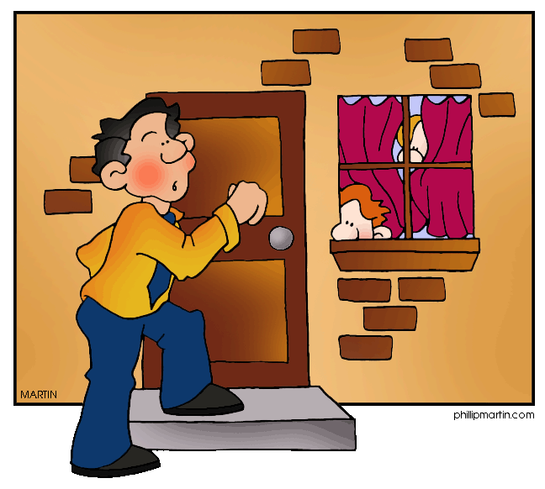
400 Made from/of
What is the house made of?

Slide 49
400 Made from/of
What is made of bricks?

Slide 50
500 Made from/ of
What is the Statue of Liberty made of?

Slide 51
500
Made from/ of
What is made of copper?

