Slide 1
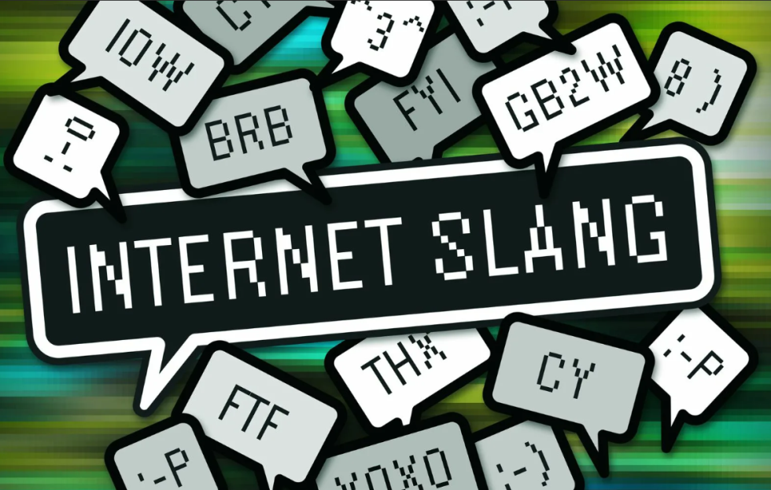
The influence of gaming slang on English speech
The presentation was made by
Darsen Badgaev. Form-11A.
Teacher: Goryaeva Irina Alexandrovna

Slide 2
What is gaming slang
Game slang is a conditional language used by players in various games to exchange information. The emergence of gaming slang is associated with the emergence of massive online games, where it has become an integral part of the game play. Game slang is characterized by brevity, and the content and emotionality associated with it, which is due to the need for rapid transmission of information and because of the emotional tension of the game.

Slide 3
Origin and development
Most of the computer jargon is created by young people who master computers and are fond of everything related to it. At the same time, the boundaries of youth and computer slang are blurred.
A large number of users from all over the world are involved in online games, and once in the same space, they are forced to resort to some universal means of communication. Thus, gaming slang serves as a way of communication for users who are native speakers of different languages. Such a "gaming" language allows you to interact quickly and easily and achieve successful gaming results. Initially, beginners do not know the words used, but over time they become simple and understandable to them, and thus the language boundaries are erased.

Slide 4
Words from gaming slang and examples
AFK Stands for “Away From Keyboard.” I'll be AFK don't start the game.
Alpha Usually the first test release of a video game. Don't be picky it's alpha
Bug A mistake in game programming that causes the game to operate incorrectly.
There are a lot of bugs in this game, it's impossible to play it.
Cheat codes Some games have special cheats that players can adopt if they know the right code.
I can't pass the level I'll have to use cheat codes

Slide 5
How can slang expressions be used outside the game environment
To begin with, I would like to say that Expressions are often used in meanings that are not characteristic of them initially.
Аre you sleepy? It's like you got up AFK.
You're so lucky it's like you entered cheat codes
This story is so bad like it's an alpha

Slide 6
Features of game slang
At the same time, within the framework of one game, slang can form within slang. For example, Dota 2 is played and interacted with by millions of players around the world at the same time, and at the same time the game has its own specifics. In this regard, there is a slang characteristic of Dota 2, reflecting its features and the needs of players, and at the same time used inside this game.

Slide 7
Different games have different communities and different slang and it is common depending on the popularity of the game itself.
Each case is unique and different games have different slang in terms of volume. For example, after listening to the speech of some gamers, an ordinary person may not understand some specific words. However, let's say after listening to the dialogue of two players in strategy games, the layman will not be able to understand what it is all about

Slide 8
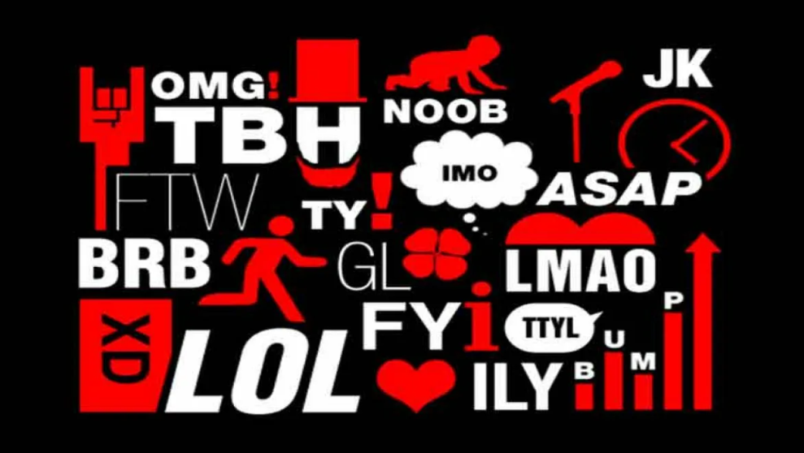
gaming slang mainly affects players in certain games, but some expressions can be used outside of them. Gaming slang is as huge as the number of games is huge and it's impossible to understand everything, but in fact it's not really necessary because most words are needed only for gamers themselves

Slide 9
Thank you for your attention!

