Slide 1
« Sport and outdoor activities»
«Спорт и занятия на открытом воздухе»
Сборник дидактики к УМК “RainbowEnglish» для 8 класса под редакциейО.В. Афанасьевой
Составитель:учитель английского языка
МБОУ «СОШ №46»
Павловская В.И.

Slide 2














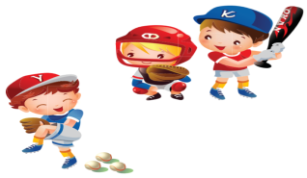
Wordsearch – Поиск ( 15 слов)
1
f | b | e | j | o | o | n | e | t | b | o | u | f | n
e | a | r | c | h | e | r | y | r | f | v | d | o | a
k | s | e | t | u | i | o | r | l | h | m | s | o | l
p | e | z | o | o | r | v | o | n | k | f | w | t | f
e | b | o | x | i | n | g | h | w | i | e | i | b | p
b | a | s | k | e | t | b | a | l | l | n | m | a | o
o | l | k | p | r | s | c | a | a | d | c | m | l | p
l | l | i | s | e | u | k | t | r | d | h | i | l | r
l | z | i | r | y | u | n | t | p | c | i | n | i | v
t | e | n | n | i | s | p | n | e | v | n | g | p | e
e | m | g | t | e | t | t | e | i | r | g | e | f | b
t | l | e | t | r | e | c | o | d | n | p | o | b | n
o | n | o | p | c | y | c | l | i | n | g | f | l | r
v | o | l | l | e | y | b | a | l | l | s | y | i | f
9
2
8
3
10
11
4
13
12
5
6
14
15
7

Slide 3
Key : Wordsearch – Поиск
1
 | b |  |  |  |  |  |  |  |  |  |  | f
 | a | r | c | h | e | r | y |  | f |  |  | o
 | s |  |  |  |  |  |  | l |  |  | s | o
 | e |  |  |  |  |  | o |  |  | f | w | t
 | b | o | x | i | n | g |  |  |  | e | i | b
b | a | s | k | e | t | b | a | l | l | n | m | a
 | l | k |  | r |  |  |  |  |  | c | m | l
 | l | i |  |  | u |  |  |  |  | h | i | l
 |  | i |  |  |  | n |  |  |  | i | n
t | e | n | n | i | s |  | n |  |  | n | g
 |  | g |  |  |  |  |  | i |  | g
 |  |  |  |  |  |  |  |  | n |  | o
 |  |  |  | c | y | c | l | i | n | g |  | l
v | o | l | l | e | y | b | a | l | l |  |  |  | f
9
2
8
3
10
11
4
12
13
5
6
14
15
7

Slide 4
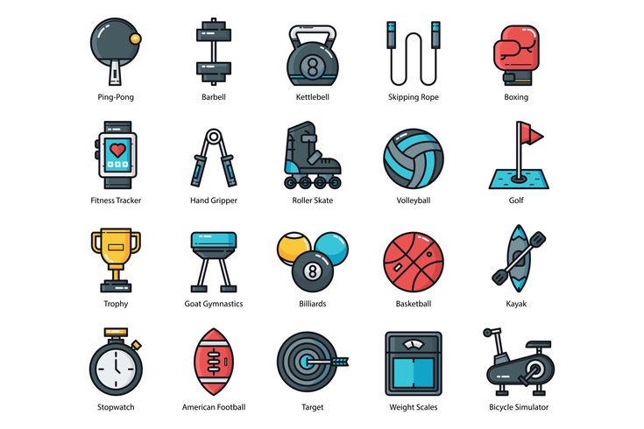
Sports Equipment

Slide 5
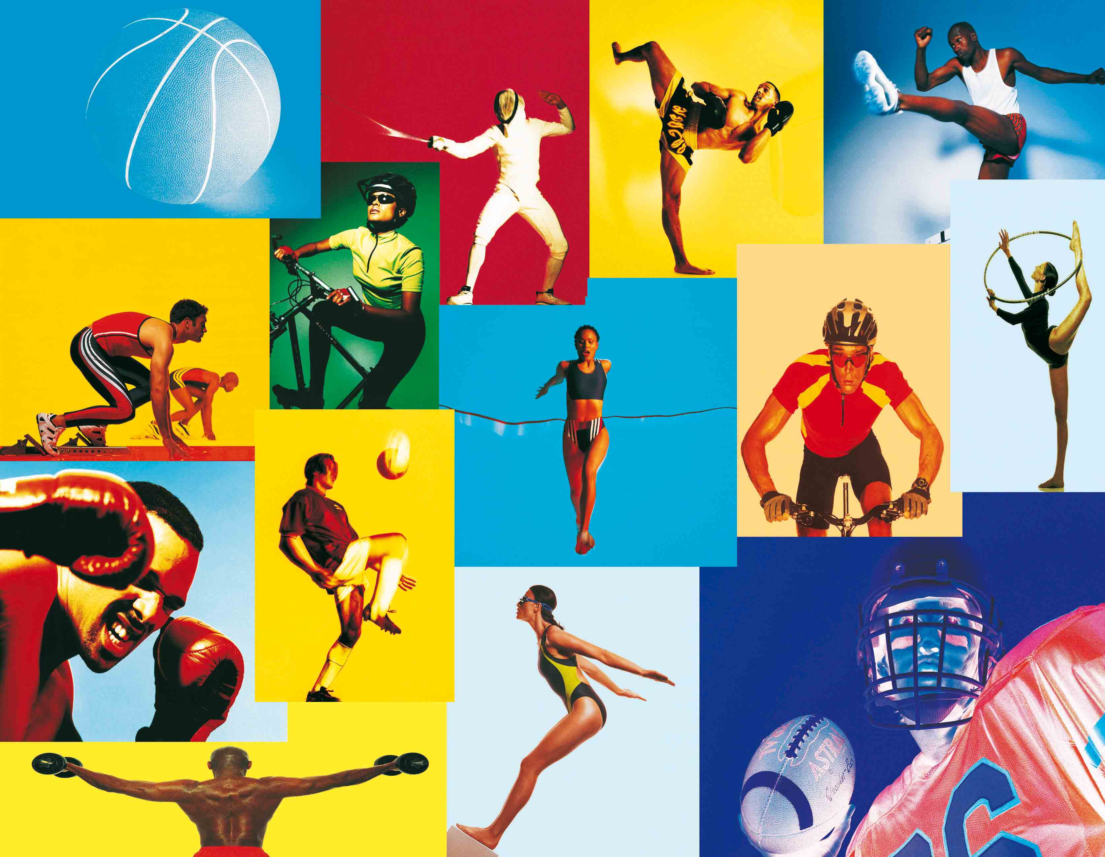
Sportswear –Cпортивная одежда

Slide 6
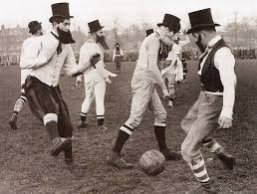
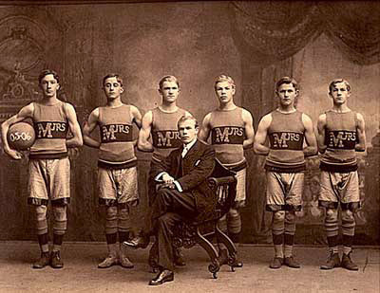
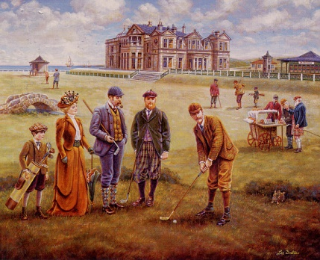
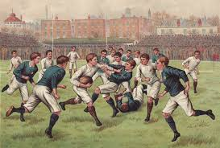
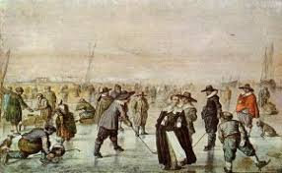
The birthplace of sports games – Родина спортивных игр
The USA
England
Scotland
England
Canada

Slide 7


Symbols of the Olympics Games in Russia
Moscow 1980
2014

Slide 8


Diamond Word ( Sport )
agoy _ _ _ _
trakae _ _ _ _ _ _
inkisg _ _ _ _ _ _
njiupmg _ _ _ _ _ _ _
abogitn _ _ _ _ _ _ _

Slide 9
Diamond Word ( Sport )
agoy _ _ _ _
trakae _ _ _ _ _ _
inkisg _ _ _ _ _ _
njiupmg _ _ _ _ _ _ _
abogitn _ _ _ _ _ _ _
Key : ( skiing, jumping, yoga, karate ,boating)

Slide 10

Rebus -1

Slide 11

Rebus -2

Slide 12

Rebus -3

Slide 13

Rebus -4

Slide 14
Keys
№1-Parkour
№ -Windsurfing
№3 –Chess
№4 -Judo

Slide 15
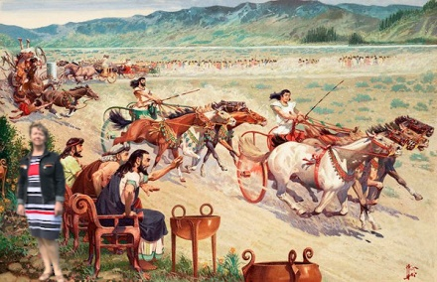
I am going to give you a talk about ...
The history of the Olympic Games

Slide 16
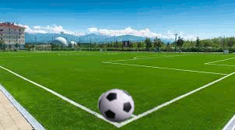
Do you like to play football?

Slide 17


